Slide 1

SQL Exploratory Data Analysis :
Grocery Dataset
Pavan

Slide 2
Overview
For this project I used PostgreSQL server.
First we want to import our dataset into Postgresql . I left all the fields as they originally were in order to show you some things you can do to edit your dataset in console.
Now we’re all set to import our data set.

Slide 3
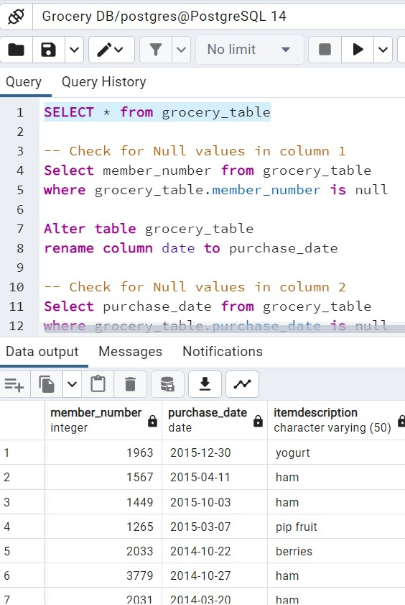
Preview the dataset
You will see that all of our data is there. And we have the right number of rows, and the right number of columns. All good there.

Slide 4
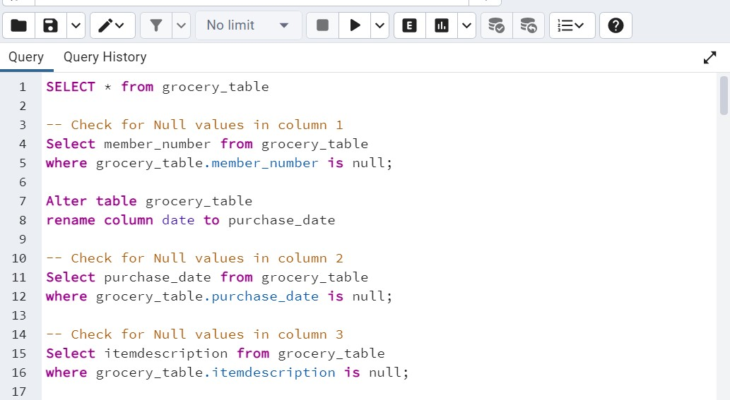
Check For Null Values & Renaming necessary column
Check for Null values in Column 1. This did not return anything which is of course what we want. Let’s do the same for the other 2 columns. No results again.

Slide 5
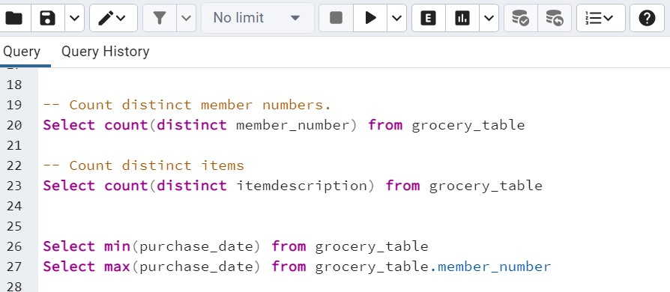
Analysis
Number of Records: 38,765
Unique Customers: 3898
Unique Items: 167
Date Begins: 2014–01–01
Date Ends: 2015–12–30

Slide 6
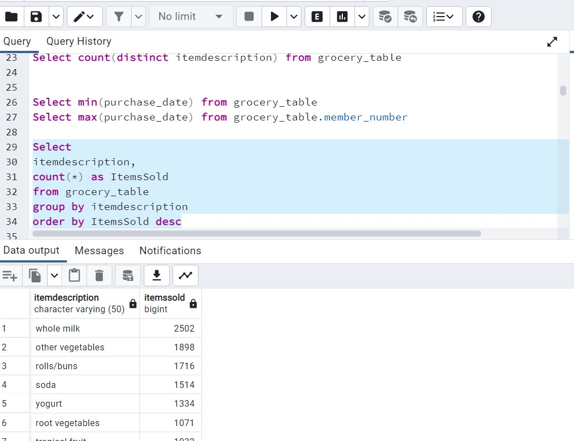
Most Popular Items Sold?

Slide 7
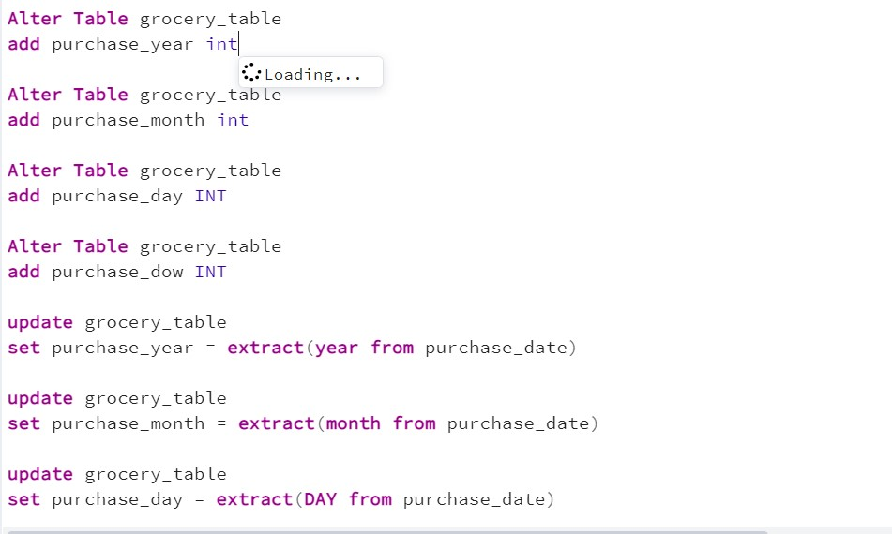
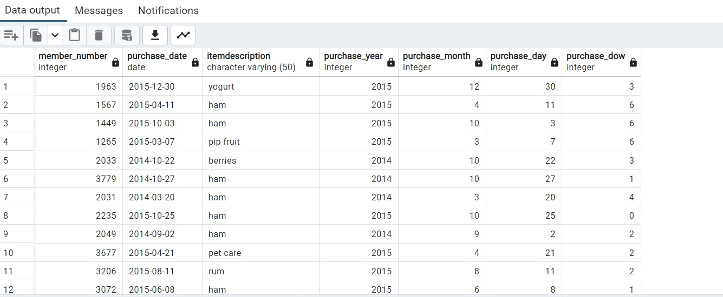
extracting the year, month, day, and day of the week

Slide 8
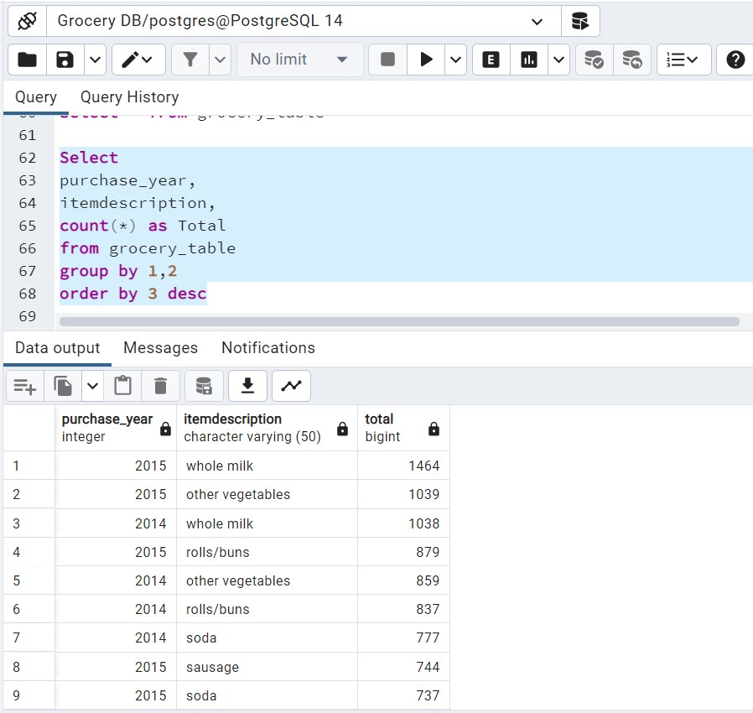
Most Popular Products by Year

Slide 9
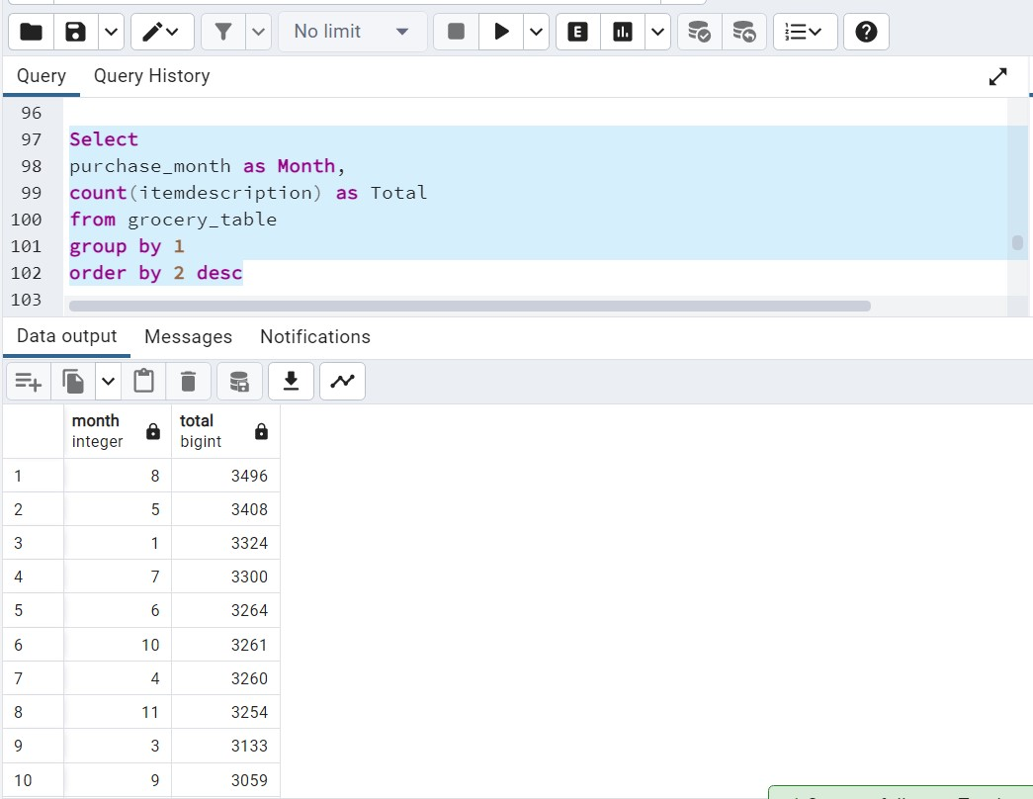
Sales Volume By Month

Slide 10
Adding Sales Revenue Information
Alter Table grocery_table
add price DECIMAL
update grocery_table
set price = random() from generate_series(1,38765)

Slide 11
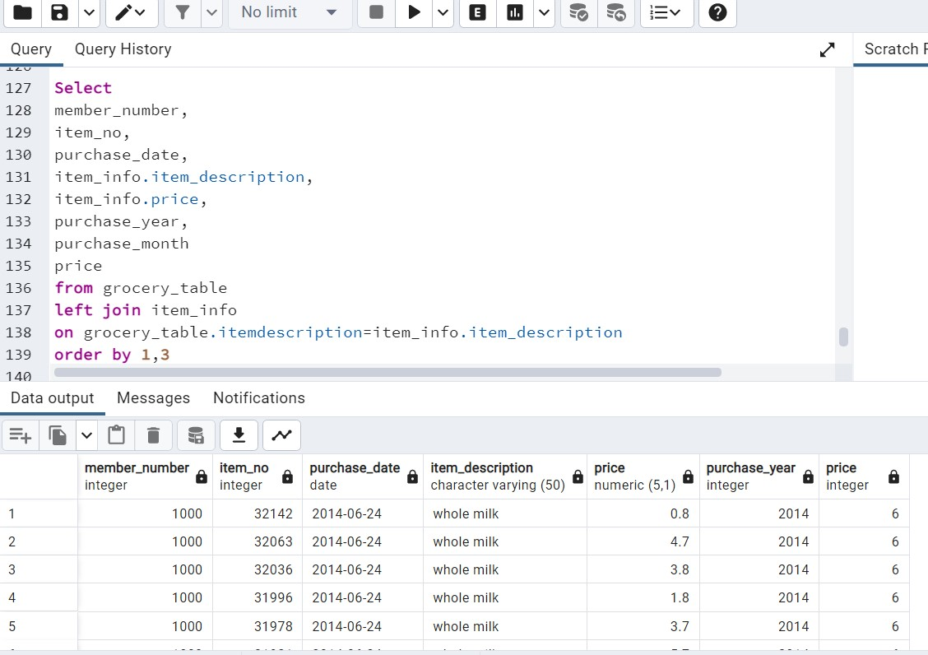
JOIN The Two Tables

Slide 12
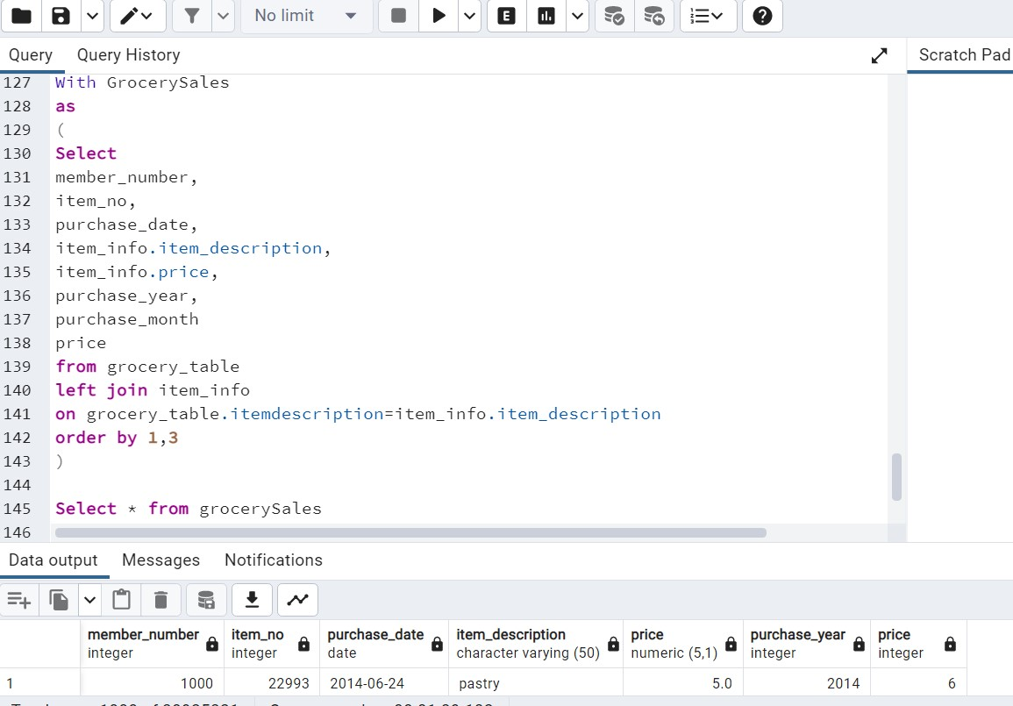
CTE

